Slide 1
Final Project:
Snake
Created By: Isaiah Dicristoforo, Johnathan Juilfs, Rachel Lindquist, Gabby McClimans, and Kenneth Otero

Slide 2
Team Members
Kenneth Otero - Team Lead
Isaiah Dicristoforo - Lead Developer
Rachel Lindquist - Asset Designer
Gabby McClimans - Developer
Johnathan Juilfs - Developer

Slide 3
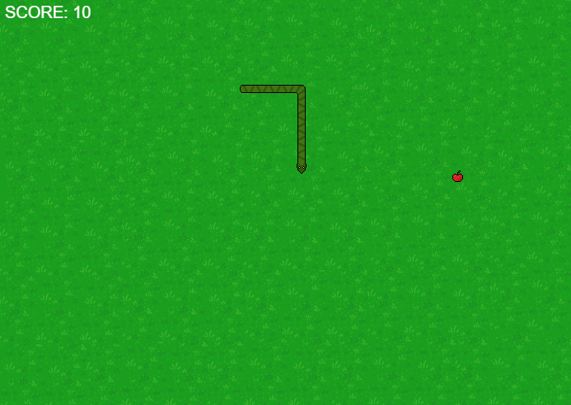
Project Idea
Our team sought to create a version of Snake for our final project. When first loading in, the player is prompted for their username, then they are able to access the game, this is needed to track their high scores. The player can control the snake using their keyboard’s arrow keys to eat food placed randomly within the world. The objective is to eat as much food as possible without colliding with the edges of the game or the snake body itself.

Slide 4
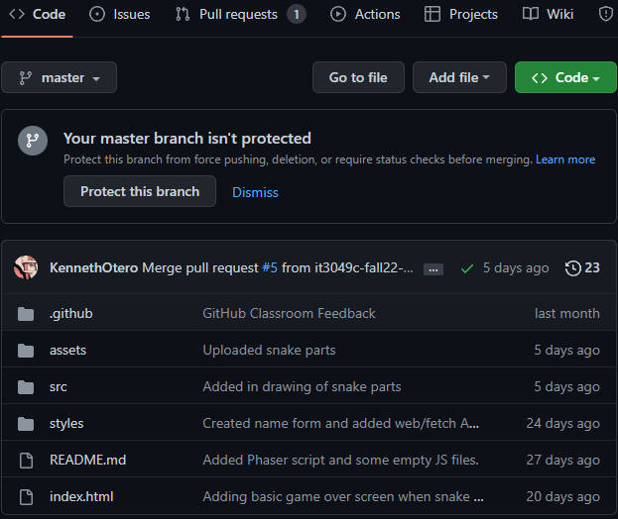
Development Process
Our team used Microsoft Teams to maintain communication with one another and discuss potential game features and delegate tasks to each other. We also used a shared repository on GitHub to collaborate on the project, create branches, and merge any big changes into our game. The game is also hosted via GitHub pages, making it easy to see our main build in action.

Slide 5
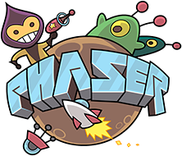
Technologies Used
Our game was built using the Phaser 3, a free game engine useful for creating web based games. We also utilized two different Web APIs, Geoapify and Weatherbit. We gather the longitude and latitude coordinates from the player and change the background color of the page depending on their city. We also use their coordinates to determine the player’s current weather forecast, and update the color of the game title if a certain condition is met (e.g., raining = blue title).

Slide 6
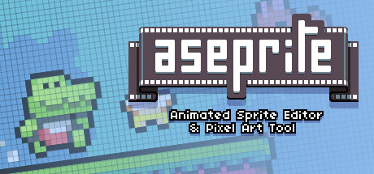
Technologies Used Cont.
For displaying our scores, we have decided to use local storage, which will then confirm that the high score was then saved. To show them in order, we are using an array.sort function to assist the sorting. Updating scores uses array.splice to insert the new score into the correct area and also forces the array length to be 10 using JSON.stringify.
For the asset creation, Aseprite, a 2d pixel art tool, was used.

Slide 7
Demonstration
Game link: Snake Game
Repository link: GitHub Repo

Slide 8
Resources Used
Our team referenced another example of a snake game made in Phaser in order to elongate our snake body upon scoring. It mainly involved keeping track of a group of snake assets, their coordinates, and moving them after a set amount of time.
Snake creation: Phaser - Examples - games - Snake

